Slide 1


End- Sem Presentation
Topic
Sign Language Recognition
Under the supervision of :- Mr. Neeraj Kaushik
Group member Roll Number
Rajkumar 225/PCA/011
Shabnam Kumari 225/PCA/027
Soni Saraswat 225/PCA/030
Akanksha Tyagi 225/PCA/026

Slide 2
Contents :
Sign Language Recognition
Introduction
Motivation
Communication challenges
Problem Statement
Objective
Diagram
Proposed Work
Understanding sign language recognition
How sign language recognition works
Description of overall software structure
Result
Application of sign language recognition
Uses in education
Workplace application
Future directions and innovations
Conclusion
References

Slide 3

Slide 1: Sign language Recognition
Title: "Sign Language Recognition: A Technological Gateway to Inclusivity"
Subtitle: "Unlocking Communication for the Deaf Community"
Visual: A powerful image of sign language gestures
Your Name and Date

Slide 4
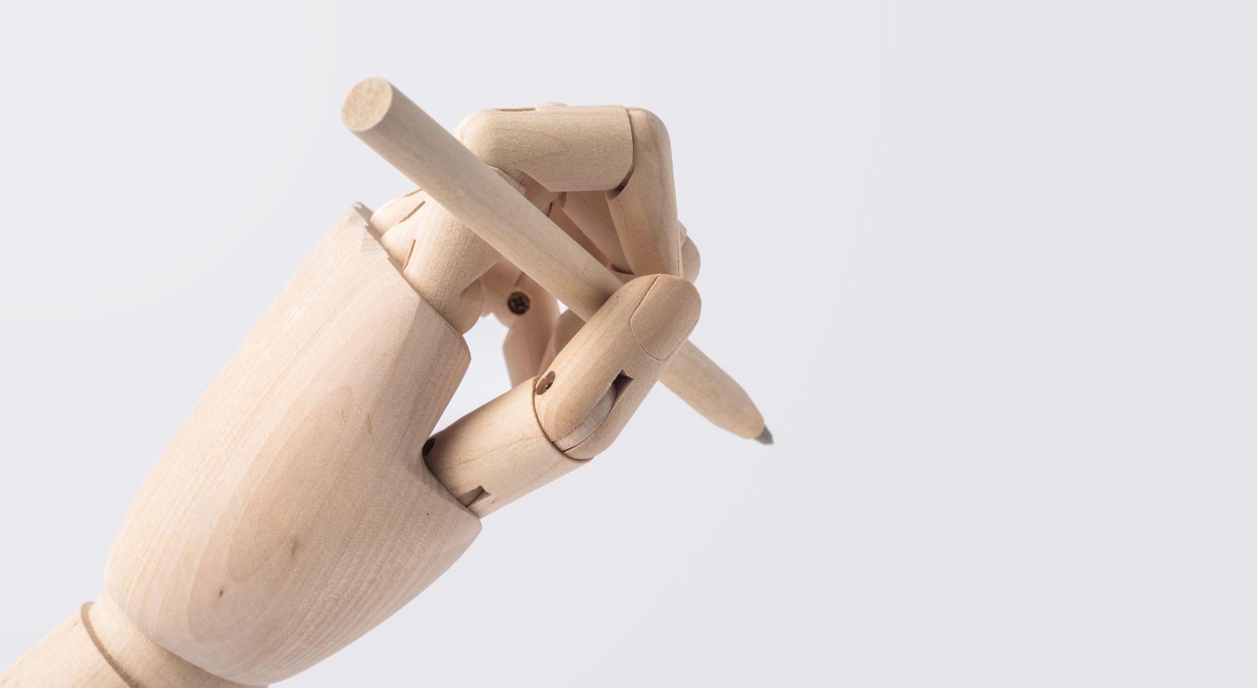
Slide 2: Introduction
• The world is hardly live without communication, no matter whether it is in the form of texture, voice or visual expression.
• The communication among the deaf and dumb people is carried by text and visual expressions.
• Gestural communication is always in the scope of confidential and secure communication.
• Hands and facial parts are immensely influential to express the thoughts of human in confidential communication.

Slide 5
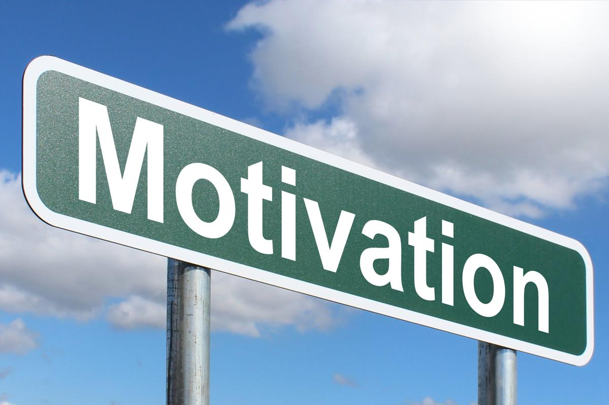
Slide 3 : Motivation
• Sign language is learned by deaf and dumb, and usually it is not known to normal people, so it becomes a challenge for communication between a normal and hearing impaired person.
• Its strike to our mind to bridge the between hearing iasiaired and normal people lo make the communication
• Sign language recognition (SLR) system takes an input expression from the hearing impaired person gives output to the normal person in the form text or voice.

Slide 6
Slide 4: Communication Challenges
Challenges Faced
Limited accessibility to spoken language
Communication barriers in education, workplaces, and daily interactions
The role of technology in overcoming these challenges

Slide 7

Slide 5: Problem Statement
• Understanding the exact context of symbolic expressions of deaf and dumb people is the challenging job in real life until unless it is properly specified.

Slide 8

Slide 6: Objective
• Communication is always having a great impact in every domain and how it is considered the meaning of the thoughts and expressions that attract the researchers to bridge this gap for every living being.
• The objective of this project is to identify the symbolic expression through images so that the communication gap between a normal and hearing impaired person can be easily bridged.

Slide 9
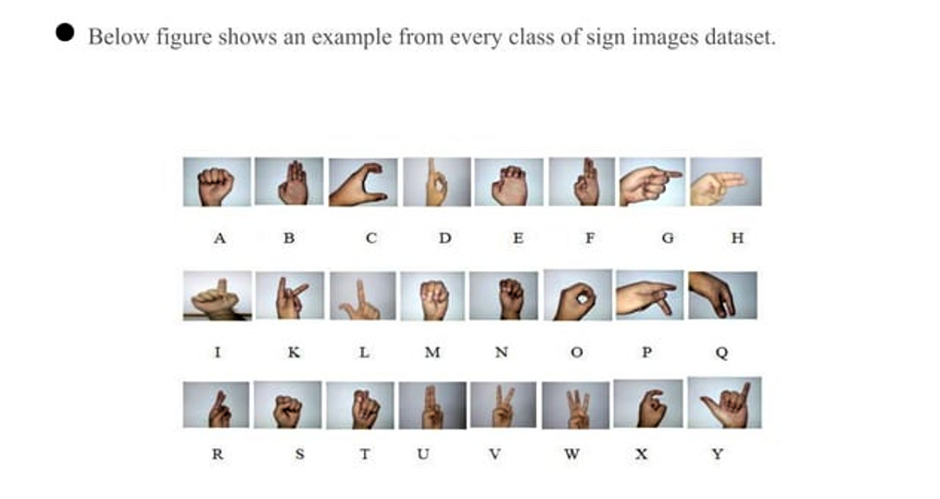
Slide 7 : Diagram

Slide 10
Slide 8: Proposed Work
In this work, we proposed an idea for feasible communication between hearing impaired and normal person with the help of-
Deep Learning
CNN
Alex Net
Machine Learning
SVM
Random Forest
KNN

Slide 11
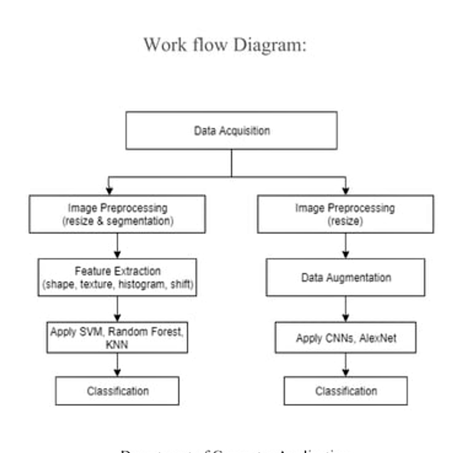

Slide 12
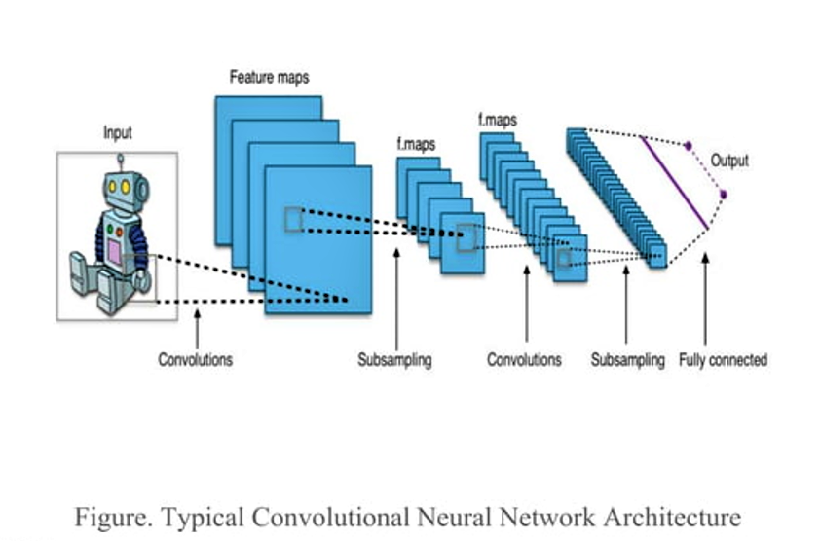

Slide 13
Slide 10: Understanding Sign Language Recognition
Gestures and Movements:
Sign languages use a combination of hand shapes, movements, and facial expressions to convey meaning.
Hand shapes:
Signs often involve specific hand shapes or configurations, and these are crucial for understanding the meaning.
Facial Expressions:
Facial expressions play a significant role in sign language, providing grammatical and emotional context.

Slide 14
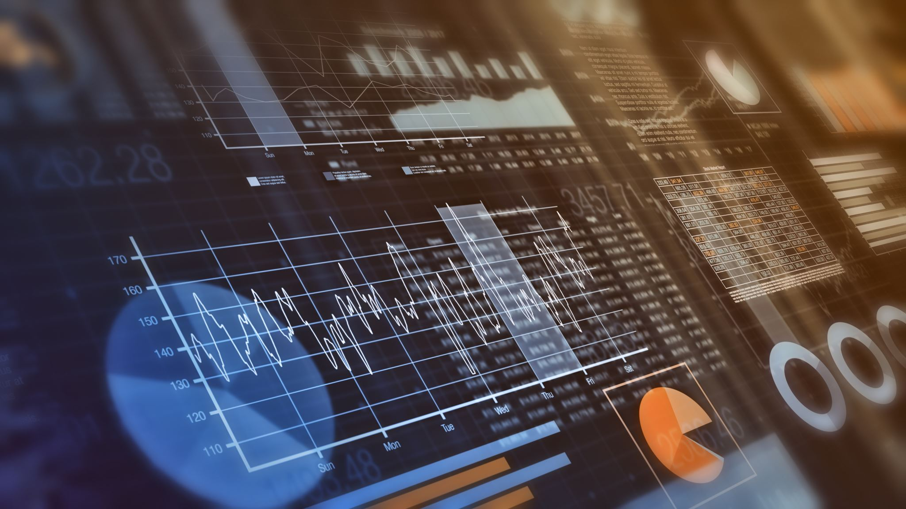
Slide 11: How Sign Language Recognition Works
Technical Insights
Computer vision and image processing
Machine learning and deep learning algorithms
Real-time applications in recognizing and translating sign language

Slide 15
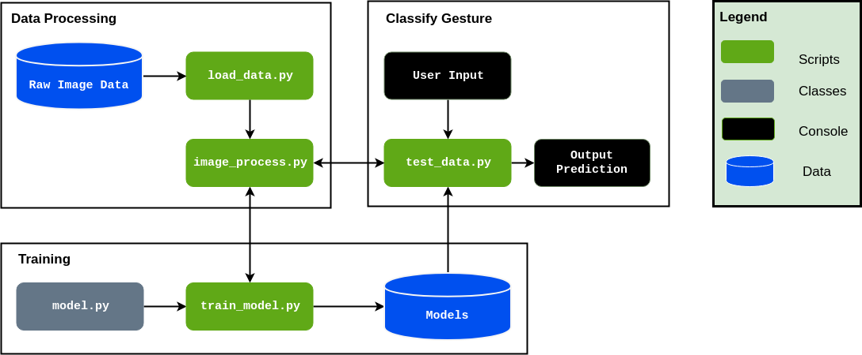
Slide 12: Description of Overall Software Structure

Slide 16
Slide 13: Result

Slide 17

Slide 14: Applications of Sign Language Recognition
Healthcare:
Sign language recognition can be applied in healthcare settings to improve communication between deaf patients and healthcare professionals. I
Education:
Sign language recognition can be used in educational settings to provide real-time feedback and support for learners of sign language, both deaf and hearing individuals.
Mobile Applications:
Mobile applications with sign language recognition can be developed for various purposes, including social media, messaging, and day-to-day communication.

Slide 18
Slide 15: Uses in Education
Enhancing Learning
Sign language recognition in classrooms
Educational apps for teaching sign language
Facilitating communication between students and educators

Slide 19

Slide 16: Workplace Applications
Improving Professional Environments
Assistive technologies for deaf employees
Communication tools in meetings and collaborative projects
Inclusive work environments through sign language recognition

Slide 20
Slide 17: Future Directions and Innovations
Ongoing Developments
Advanced gesture recognition technologies
Integration with augmented reality
Multimodal communication systems for a richer experience

Slide 21
Slide 18: Conclusion
Recap and Key Takeaways
Sign Language Recognition as a catalyst for inclusivity
The diverse range of applications and uses
The continued importance of research and development in this field

Slide 22
References
Bantupalli, K., & Xie, Y. (2018). American Sign Language Recognition using Deep Learning and Computer Vision. 2018 IEEE International Conference on Big Data (Big Data).
A. Tharwat, T. Gaber, A. E. Hassanien, M. K. Shahin, and B. Refaat, ‘‘Sift-based arabic sign language recognition system,’’ in Proc. AfroEur. Conf. Ind. Advancement. Cham, Switzerland: Springer, 2015, pp. 359–370.
] R. Cui, H. Liu, and C. Zhang, ‘‘A deep neural framework for continuous sign language recognition by iterative training,’’ IEEE Trans. Multimedia, vol. 21, no. 7, pp. 1880–1891, Jul. 2019.
P. S. Santhalingam, P. Pathak, J. Košecká, and H. Rangwala, ‘‘Sign language recognition analysis using multimodal data,’’ in Proc. IEEE Int. Conf. Data Sci. Adv. Anal. (DSAA), Oct. 2019, pp. 203–210.

Slide 23
THANK YOU

